Slide 1
Java 9 new features

Slide 2
Jigsaw / Java Platform Module System (JPMS)
A Java module can specify which of the Java packages it contains that should be visible to other Java modules using this module
Java module must also specify which other Java modules is requires to do its job
Notes:
Modular JDK
Modular Java Source Code
Modular Run-time Images
Encapsulate Java Internal APIs
Java Platform Module System

Slide 3
Java Module Benefits
Smaller Application Distributable via the Modular Java Platform
Encapsulation of Internal Packages
Startup Detection of Missing Modules
Notes:
Encapsulation of Internal Packages
A Java module must explicitly tell which Java packages inside the module are to be exported (visible) to other Java modules using the module.
A Java module can contain Java packages which are not exported.
Classes in unexported packages cannot be used by other Java modules. Such packages can only be used internally in the Java module that contains them.
Packages that are not exported are also referred to as hidden packages, or encapsulated packages.
Startup Detection of Missing Modules
From Java 9 and forward, Java applications must be packaged as Java modules too.
Therefore an application module specifies what other modules (Java API modules or third party modules) it uses.
Therefore the Java VM can check the whole module dependency graph from the application module and forward, when the Java VM starts up.
If any required modules are not found at startup, the Java VM reports the missing module and shuts down.
Before Java 9 missing classes (e.g. from a missing JAR file) would not be detected until the application actually tried to use the missing class.
This would happen sometime at runtime - depending on when the application tried to use the missing class.

Slide 4
Java Module Basics
Module Naming
Module Root Directory
Module Descriptor (module-info.java)
Module Exports
Module Requires
Circular Dependencies Not Allowed
Notes:
Encapsulation of Internal Packages
A Java module must explicitly tell which Java packages inside the module are to be exported (visible) to other Java modules using the module.
A Java module can contain Java packages which are not exported.
Classes in unexported packages cannot be used by other Java modules. Such packages can only be used internally in the Java module that contains them.
Packages that are not exported are also referred to as hidden packages, or encapsulated packages.
Startup Detection of Missing Modules
From Java 9 and forward, Java applications must be packaged as Java modules too.
Therefore an application module specifies what other modules (Java API modules or third party modules) it uses.
Therefore the Java VM can check the whole module dependency graph from the application module and forward, when the Java VM starts up.
If any required modules are not found at startup, the Java VM reports the missing module and shuts down.
Before Java 9 missing classes (e.g. from a missing JAR file) would not be detected until the application actually tried to use the missing class.
This would happen sometime at runtime - depending on when the application tried to use the missing class.

Slide 5
Java Module Basics
Unnamed Module
Automatic Modules
Services
Notes:
Unnamed Module
From Java 9 and forward, all Java classes must be located in a module for the Java VM to use them. But what do you do with older Java libraries where you just have the compiled classes, or a JAR file?
In Java 9 you can still use the -classpath argument to the Java VM when running an application. On the classpath you can include all your older Java classes, just like you have done before Java 9. All classes found on the classpath will be included in what Java calls the unnamed module.
The unnamed module exports all its packages. However, the classes in the unnamed module are only readable by other classes in the unnamed module.
No named module can read the classes of the unnamed module.
If a package is exported by a named module, but also found in the unnamed module, the package from the named module will be used.
All classes in the unnamed module requires all modules found on the module path. That way, all classes in the unnamed module can read all classes exported by all the Java modules found on the module path.
Automatic Modules
What if you are modularizing your own code, but your code uses a third party library which is not yet modularized?
While you can include the third party library on the classpath and thus include it in the unnamed module, your own named modules cannot use it, because named modules cannot read classes from the unnamed module.
The solution is called automatic modules. An automatic module is made from a JAR file with Java classes that are not modularized, meaning the JAR file has no module descriptor.
This is the case with JAR files developed with Java 8 or earlier. When you place an ordinary JAR file on the module path (not the classpath) the Java VM will convert it to an automatic module at runtime.
An automatic module requires all named modules on the module path. In other words, it can read all packages exported by all named modules in the module path.
If your application contains multiple automatic modules, each automatic module can read the classes of all other automatic modules.
An automatic module can read classes in the unnamed module. This is different from explicit named modules (real Java modules) which cannot read classes in the unnamed module.
An automatic module exports all its packages, so all named modules on the module path can use the classes of an automatic module. Named modules still have to explicitly require the automatic module though.
The rule about not allowing split packages also counts for automatic modules. If multiple JAR files contain (and thus exports) the same Java package, then only one of these JAR files can be used as an automatic module.
An automatic module is a named module. The name of an automatic module is derived from the name of the JAR file. If the name of the JAR file is com-jenkov-mymodule.jar the corresponding module name will be com.jenkov.mymodule. The - (dash) characters are not allowed in a module name, so they are replaced with the . character. The .jar suffix is removed.
If a JAR file contains versioning in its file name, e.g. com-jenkov-mymodule-2.9.1.jar then the versioning part is removed from the file name too, before the automatic module name is derived. The resulting automatic module name is thus still com.jenkov.mymodule .
Services
With Java 9 comes a new concept called services. Java services is related to the Java Platform Module System, so I will explain Java services in this Java module tutorial.
A service consists of two major parts:
A service interface.
One or more service implementations.
The service interface is typically located in a service interface Java module which only contains the service interface, plus any classes and interfaces related to the service interface.
The service implementations are provided by separate Java modules - not the service interface module. Typically a service implementation Java module will contain a single service implementation.
A Java module or application can require the service interface module and code against the service interface, without knowing exactly which other module delivers the service implementation. The service implementation is discovered at runtime, and depends on what service implementation modules are available on the Java module path when the application is launched.

Slide 6
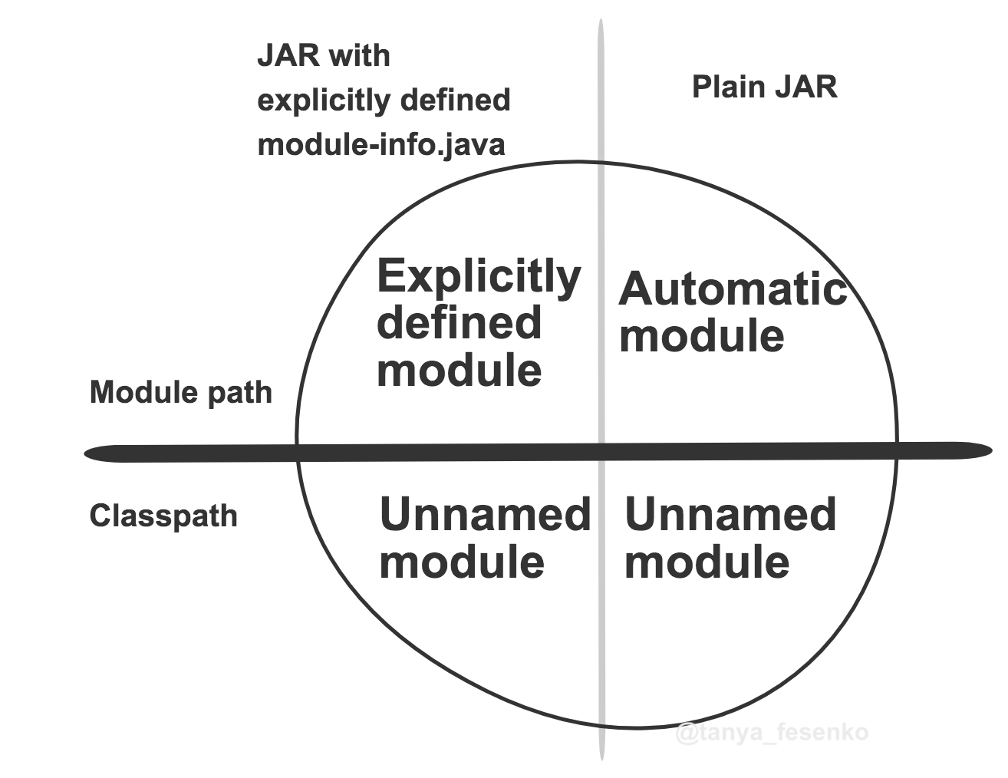

Slide 7
Multiversion JAR file
META-INF
MANIFEST.MF
versions
10
com
9
com
com
Notes:
From Java 9 it is possible to create JAR files for Java modules which contains code compiled specifically for different versions of Java.
That means, that you can create a JAR file for your module that contains code compiled for Java 8, Java 9, Java 10 etc. - all within the same JAR file.
Here is how the structure looks of a multi Java version JAR file:

Slide 8
HTTP2 client library
New HTTP 2 Client API to support HTTP/2 protocol and WebSocket features.
As existing or Legacy HTTP Client API has numerous issues
The new API is replacing this HttpURLConnection API with new HTTP client.
under “java.net.http” package
Notes:
(like supports HTTP/1.1 protocol and does not support HTTP/2 protocol and WebSocket, works only in Blocking mode and lot of performance issues.),

Slide 9
Java 9 REPL(Read Evaluate Print Loop)

Slide 10
Factory Methods for Immutable List, Set, Map and Map.Entry

Slide 11
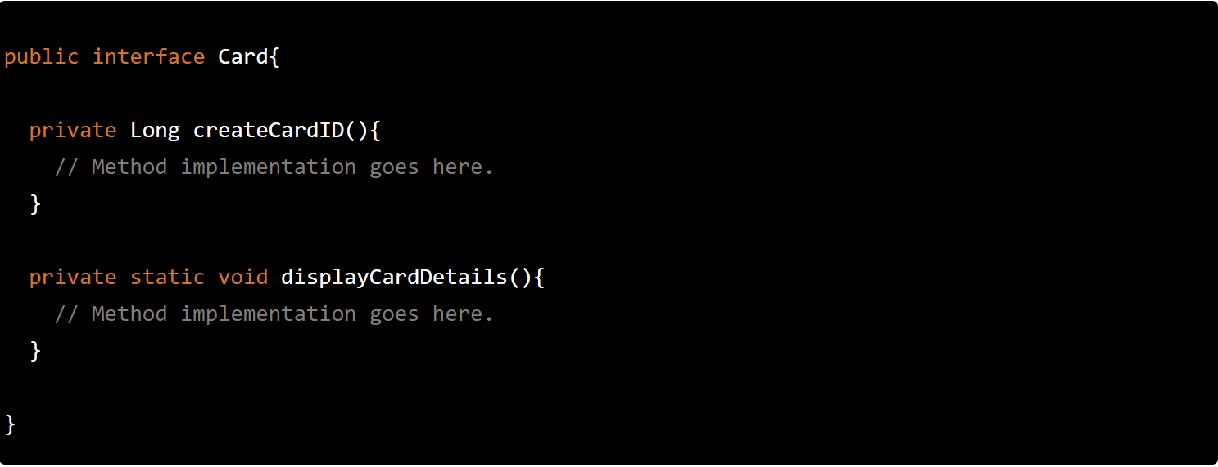
Private methods in Interfaces

Slide 12
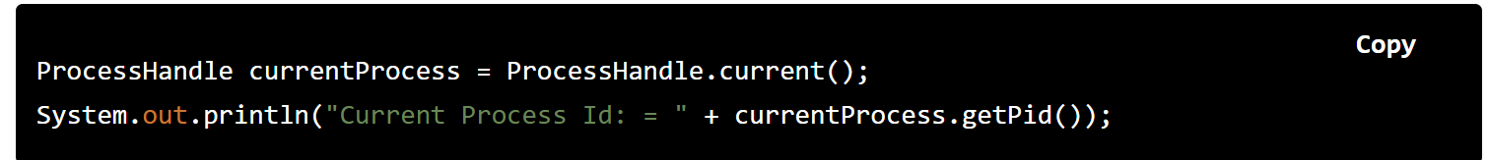
Process API Improvements
java.lang.ProcessHandle
java.lang.ProcessHandle.Info

Slide 13
Enhanced @Deprecated annotation
provide more information about deprecated API
forRemoval and since methods
Jdeprscan tool for analyze code base (jar, class, dir)

Slide 14
Other improvements
GC (Garbage Collector) Improvements
Stack-Walking API
Filter Incoming Serialization Data
Deprecate the Applet API
Indify String Concatenation
Enhanced Method Handles
Java Platform Logging API and Service
Compact Strings
Parser API for Nashorn
Javadoc Search
HTML5 Javadoc
Notes:
-XX:-CompactStrings
public class SWDemo { public static void main(String[] args) { a(); } public static void a() { b(); } public static void b() { c(); } public static void c() { StackWalker sw = StackWalker.getInstance(); sw.forEach(System.out::println); } }

Slide 15
Java 10 new features

Slide 16
Long Term Support Model
Starting 2017, Oracle & the Java community announced its shift to a new 6 month cadence for Java
It moved to a Long Term Support (LTS) model for Oracle Java SE products.
LTS version of the products will offer premier and sustained support from Oracle and it will be targeted every 3 years.
New versioning model: $FEATURE.$INTERIM.$UPDATE.$PATCH
Notes:
Each Java release is modelled after one or two major feature, these features drives the release.
Any obstacle, postpones the release and late to market. Project Jigsaw was a major feature of Java 9, it pushed out the release dates a couple of times and the release was delayed by more than 1.5 years. 6 months cadence release will follow a release train.
Release train will have a schedule every 6 months. Features which make the cut get boarded on the train; else they wait for the next scheduled train.
Open JDK binaries will be released every 6 months, while Oracle JDK binaries will be releases every 3 years (LTS version)
$FEATURE: counter will be incremented every 6 months and will be based on feature release versions, e.g: JDK 10, JDK 11.
$INTERIM: counter will be incremented for non-feature releases that contain compatible bug fixes and enhancements but no incompatible changes.
Usually this will be zero, as there will be no interim release in a six month period. This kept for future revision to the release model.
$UPDATE: counter will be incremented for compatible update releases that fix security issues, regressions, and bugs in newer features.
This is updated one month after the feature release and every 3 months thereafter.
The April 2018 release is JDK 10.0.1, the July release is JDK 10.0.2, and so forth
$PATCH: counter will be incremented for an emergency release to fix a critical issue. New API’s have been added to get these counter values programmatically. Let’s take a look;

Slide 17
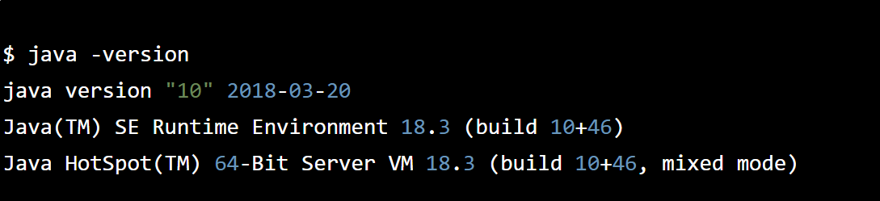
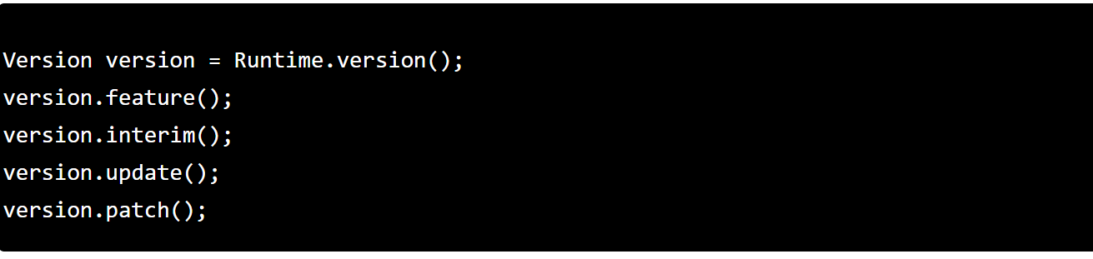
Long Term Support Model
Notes:
Each Java release is modelled after one or two major feature, these features drives the release. Any obstacle, postpones the release and late to market. Project Jigsaw was a major feature of Java 9, it pushed out the release dates a couple of times and the release was delayed by more than 1.5 years. 6 months cadence release will follow a release train.
Release train will have a schedule every 6 months. Features which make the cut get boarded on the train; else they wait for the next scheduled train.
Open JDK binaries will be released every 6 months, while Oracle JDK binaries will be releases every 3 years (LTS version)
$FEATURE: counter will be incremented every 6 months and will be based on feature release versions, e.g: JDK 10, JDK 11.
$INTERIM: counter will be incremented for non-feature releases that contain compatible bug fixes and enhancements but no incompatible changes. Usually this will be zero, as there will be no interim release in a six month period. This kept for future revision to the release model.
$UPDATE: counter will be incremented for compatible update releases that fix security issues, regressions, and bugs in newer features.
This is updated one month after the feature release and every 3 months thereafter.
The April 2018 release is JDK 10.0.1, the July release is JDK 10.0.2, and so forth
$PATCH: counter will be incremented for an emergency release to fix a critical issue. New API’s have been added to get these counter values programmatically. Let’s take a look;

Slide 18
Local-Variable Type Inference
Limited only to Local Variable with initializer
Indexes of enhanced for loop or indexes
Local declared in for loop
Notes:
Local-Variable Type Inference is the biggest new feature in Java 10 for developers. It adds type inference to declarations of local variables with initializers. Local type inference can be used only in the following scenarios:

Slide 19
Experimental Java-Based JIT Compiler
Notes:
This feature enables the Java-based JIT compiler, Graal, to be used as an experimental JIT compiler on the Linux/x64 platform.
This is by far the most futuristic inclusion in the Java 10 feature list.
Graal was introduced in Java 9. It’s an alternative to the JIT compiler which we have been used to.
It’s a plugin to the JVM, which means that the JIT compiler is not tied to JVM and it can be dynamically plugged in and replaced with any another plugin which JVMCI compliant (Java-Level JVM Compiler Interface)
Graal is a high-performance JIT compiler. It accepts the JVM bytecode and produces the machine code.

Slide 20
API Changes
API’s Added: 73 new API’s was added in Java 10.
http://cr.openjdk.java.net/~iris/se/10/latestSpec/apidiffs/overview-summary.html
API’s Removed:
http://cr.openjdk.java.net/~iris/se/10/latestSpec/#APIs-removed

Slide 21
Java 11 new features

Slide 22
The next LTS version
Java 11 is the second LTS release after Java 8.

Slide 23
Running Java File with single command
You don’t need to compile the Java source file with Javac, use can use Java directly
This feature comes under JEP 330.
Notes:
javainterpreter. The source code is compiled in memory and then executed by the interpreter. The limitation is that all the classes have to be defined in the same file.
JDK Enhancement Proposals
The in-memory compiled code is ran as part of an unnamed module with the option --add-modules=ALL-DEFAULT. This enables the code to use different modules without the need to explicitly declare dependency using the module-info.java

Slide 24
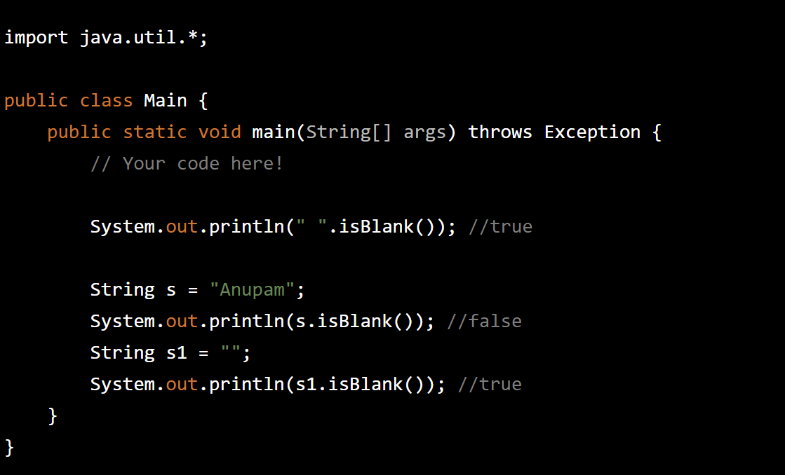
Java String Methods isBlank()

Slide 25
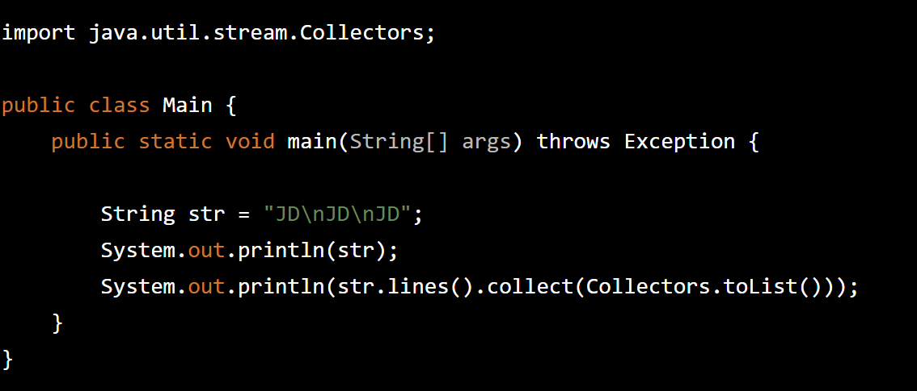
Java String Methods lines()
Notes:
This method returns a string array which is a collection of all substrings split by lines.

Slide 26
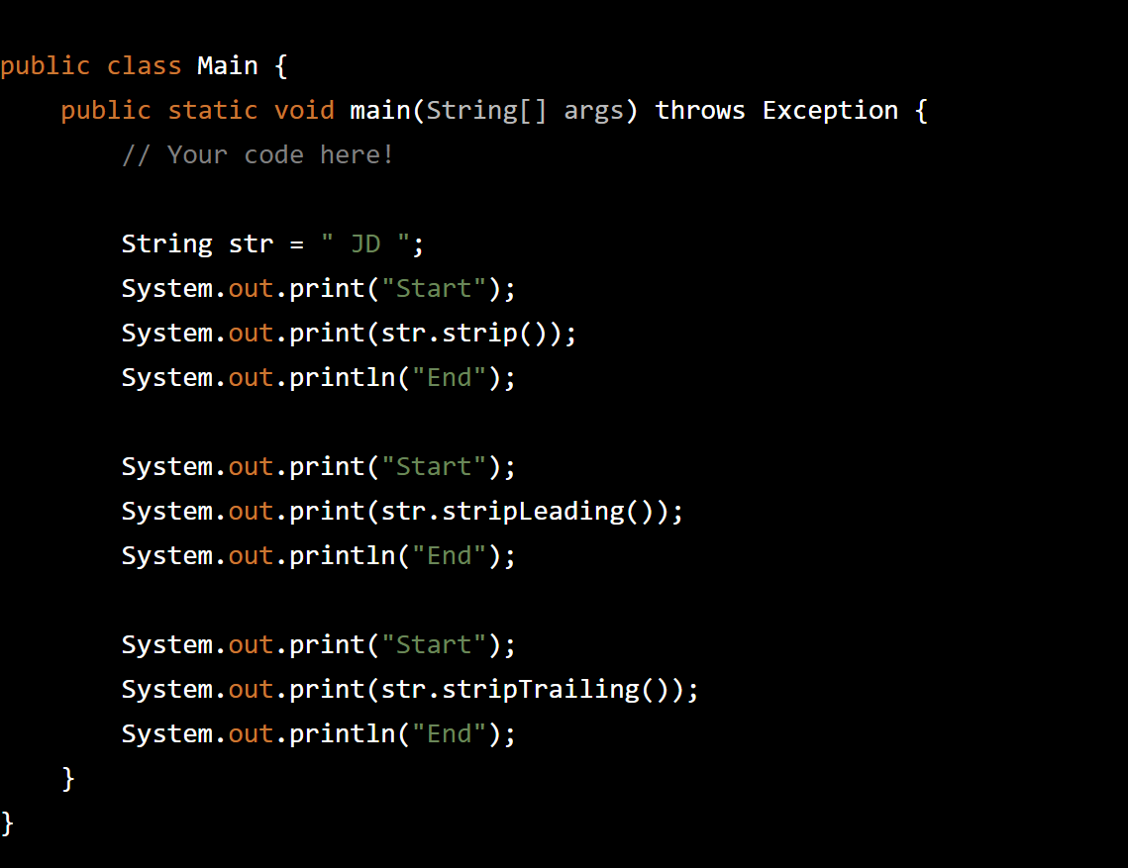
Java String Methods strip(), stripTailing(),stripLeading();
Notes:
strip() is “Unicode-aware” evolution of trim().
When trim() was introduced, Unicode wasn’t evolved. Now, the new strip() removes all kinds of whitespaces leading and trailing(check the method Character.isWhitespace(c) to know if a unicode is whitespace or not)

Slide 27
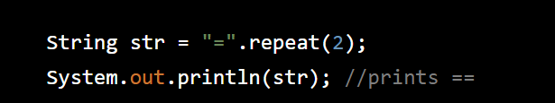
Repeat method()
Notes:
he repeat method simply repeats the string that many numbers of times as mentioned in the method in the form of an int.

Slide 28
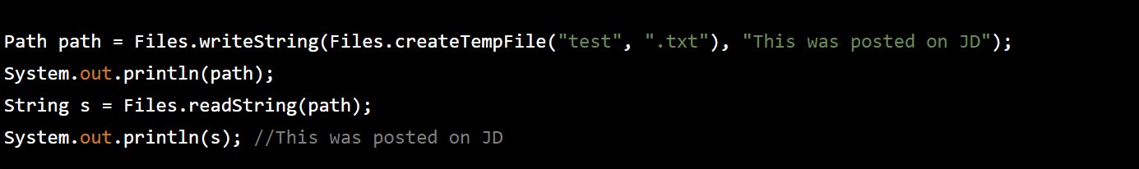
Reading/Writing Strings to and from the Files
Notes:
he repeat method simply repeats the string that many numbers of times as mentioned in the method in the form of an int.

Slide 29
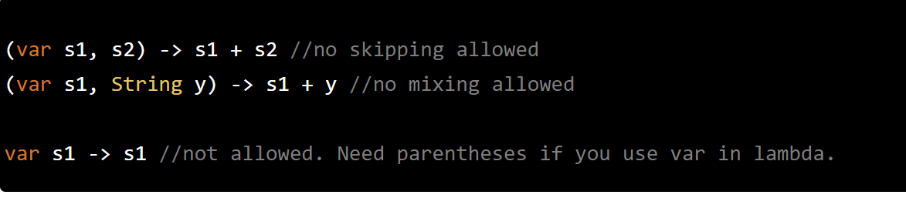
Local-Variable Syntax for Lambda Parameters

Slide 30
JVM improvements
JEP 329: ChaCha20 and Poly1305 Cryptographic Algorithms
Java 11 provides ChaCha20 and ChaCha20-Poly1305 Cipher implementations. These algorithms will be implemented in the SunJCE provider.
JEP 315: Improve Aarch64 Intrinsics
Improve the existing string and array intrinsics, and implement new intrinsics for the java.lang.Math sin, cos, and log functions, on AArch64 processors.
JEP 333: ZGC: A Scalable Low-Latency Garbage Collector (Experimental)
Java 11 has introduced a low latency GC. This is an experimental feature. It’s good to see that Oracle is giving importance to GC’s.
JEP 335: Deprecate the Nashorn JavaScript Engine
Notes:
Two new features were added to switch expressions:
Introduction of case value -> syntax that removes the need of break statements.
Now we can assign a Switch expression to a variable to return it as value of a method.
You can see these new features in the code below.

Slide 31
Java 12 new features
For developers

Slide 32
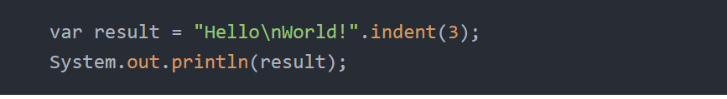
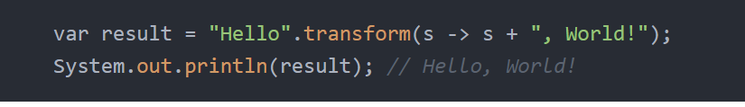
New String methods (from JEP 326): indent and transform

Slide 33
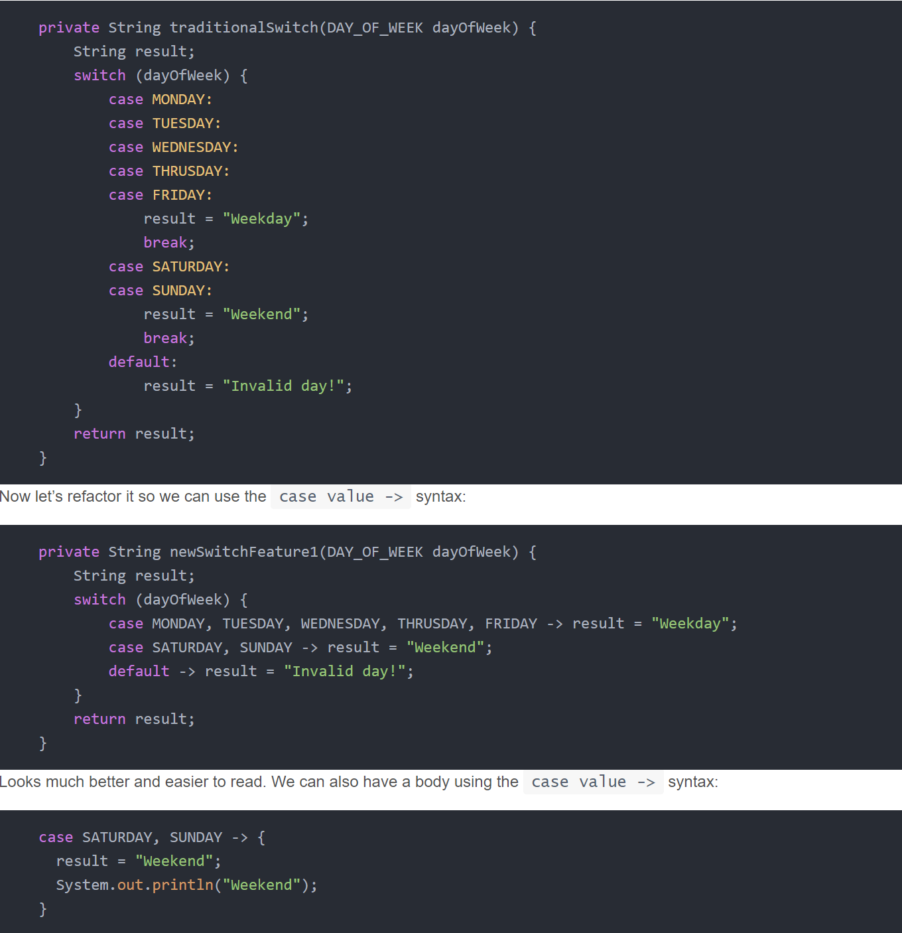
Switch Expressions (from JEP 325 - Preview Feature)
Notes:
Two new features were added to switch expressions:
Introduction of case value -> syntax that removes the need of break statements.
Now we can assign a Switch expression to a variable to return it as value of a method.
You can see these new features in the code below.

Slide 34
JVM improvements
JEP 344 – Abortable Mixed Collections for G1: Makes G1 mixed collections abortable if they might exceed the pause target.
JEP 346 – Promptly Return Unused Committed Memory from G1: Enhances the G1 garbage collector to automatically return Java heap memory to the operating system when idle.
JEP 189 – Shenandoah, A Low-Pause-Time Garbage Collector (experimental): Adds a new garbage collection (GC) algorithm which reduces GC pause times by doing evacuation work concurrently with the running Java threads.
JEP 230 – Microbenchmark Suite: Adds a basic suite of microbenchmarks to the JDK source code, and makes it easy for developers to run existing microbenchmarks and create new ones.
JEP 334 – JVM Constants API: Introduces an API to model nominal descriptions of key class-file and run-time artifacts, in particular constants that are loadable from the constant pool.
JEP 340 – One AArch64 Port, Not Two: Removes all of the sources related to the arm64 port while retaining the 32-bit ARM port and the 64-bit aarch64 port.
JEP 341 – Default CDS Archives: Enhance the JDK build process to generate a class data-sharing (CDS) archive, using the default class list, on 64-bit platforms.
Notes:
Two new features were added to switch expressions:
Introduction of case value -> syntax that removes the need of break statements.
Now we can assign a Switch expression to a variable to return it as value of a method.
You can see these new features in the code below.

